Slide 1
COST
Statistical Estimation Theory

Slide 2

Z Score
Mean
$$Z=\frac{\overline{X}−μ}{\frac{σ}{\sqrt{N}}}$$
Proportion
$$Z=\frac{P −p}{\sqrt{\frac{pq}{N}}}$$

Slide 3

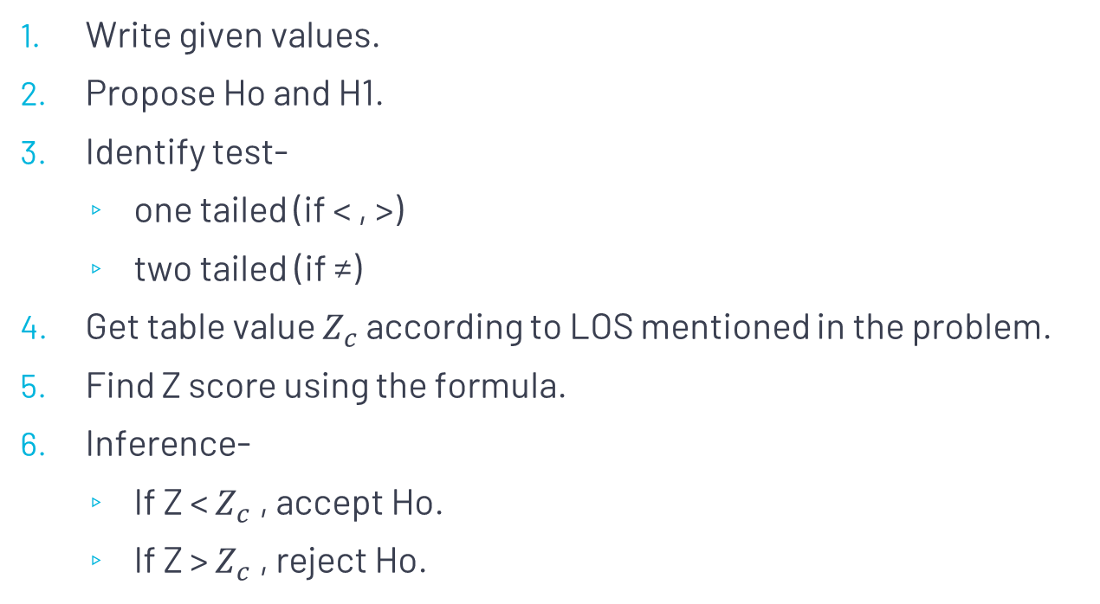

Steps for hypothesis testing
Write given values.
Propose Ho and H1.
Identify test-
one tailed (if < , >)
two tailed (if ≠)
Get table value $Z_{c}$ according to LOS mentioned in the problem.
Find Z score using the formula.
Inference-
If Z < $Z_{c}$ , accept Ho.
If Z > $Z_{c}$ , reject Ho.
Reject Ho
Accept Ho
Reject Ho
$$Z_{c}$$
$$Z_{c}$$

Slide 4
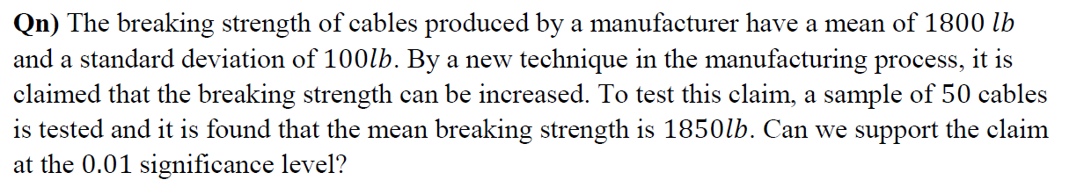
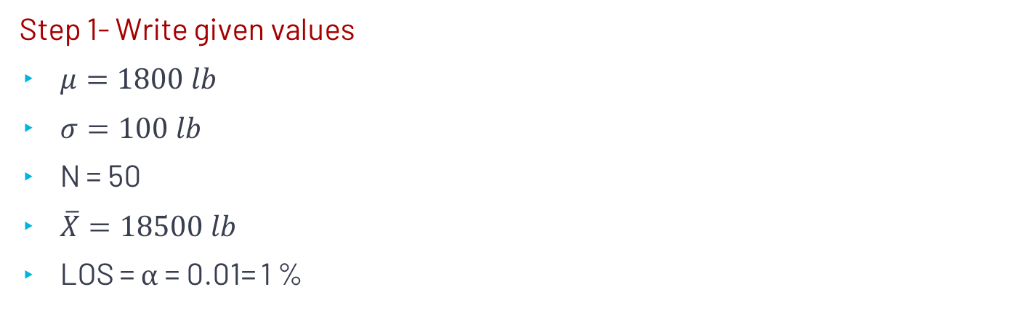
Question
Step 1- Write given values
$μ=1800 lb$
$σ=100 lb$
N = 50
$\overline{X}=18500 lb$
LOS = $α$= 0.01= 1 %
Population Parameter
Sample data

Slide 5
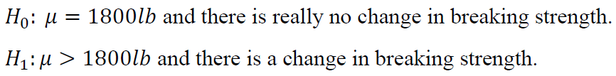
Cont..
Step 2- Propose H0
Step 3- Identify Test
As > sign is there, use One tailed Test

Slide 6
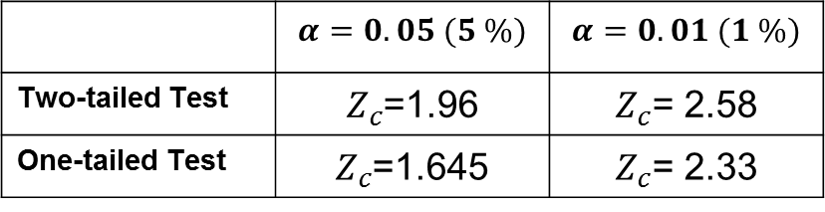
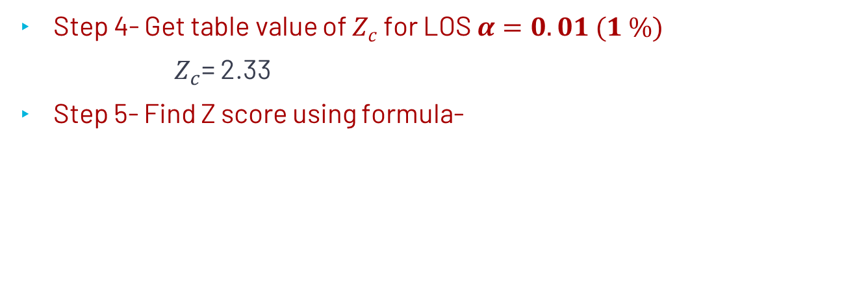

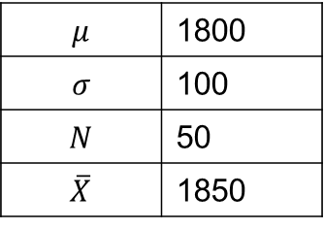

Cont.…
 | $$α=0.05 (5 \%)$$ | $$α=0.01 (1 \%)$$
Two-tailed Test | $Z_{c}$=1.96 | $Z_{c}$= 2.58
One-tailed Test | $Z_{c}$=1.645 | $Z_{c}$= 2.33
Step 4- Get table value of $Z_{c}$ for LOS $α=0.01 (1 \%)$
$Z_{c}$= 2.33
Step 5- Find Z score using formula-
$$μ$$ | 1800
$$σ$$ | 100
$$N$$ | 50
$$\overline{X}$$ | 1850
$$Z=\frac{\overline{X}−μ}{\frac{σ}{\sqrt{N}}}$$
$Z=$3.5355

Slide 7
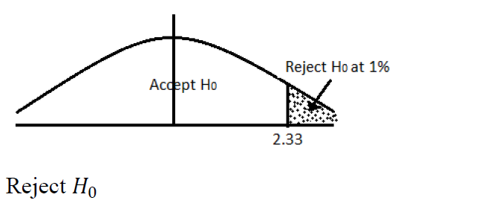
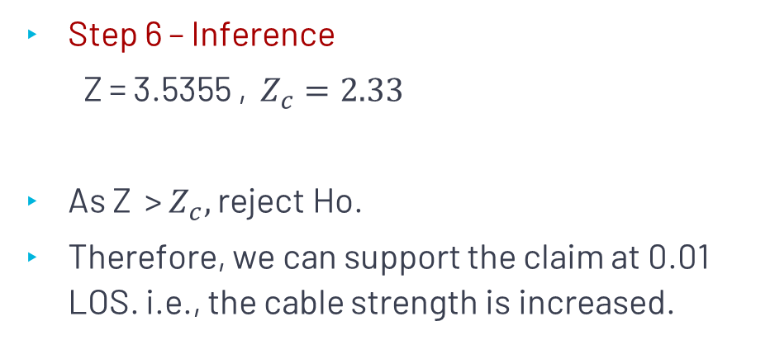
Cont. ..
Step 6 – Inference
$\text{Z}\text{ = 3.}\text{5355 , }Z_{c}=2.33$
As Z $\text{> }Z_{c},$reject Ho.
Therefore, we can support the claim at 0.01 LOS. i.e., the cable strength is increased.

Slide 8
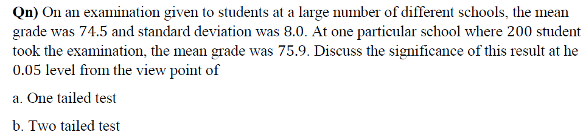
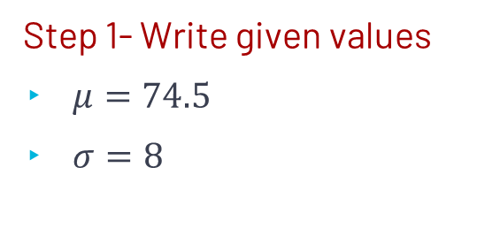
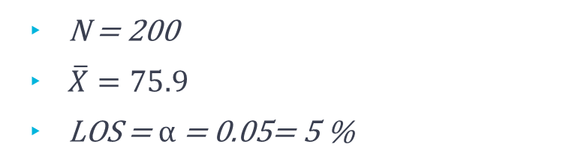
Question
Step 1- Write given values
$μ=74.5$
$σ=8$
N = 200
$\overline{X}=75.9$
LOS = $α$= 0.05= 5 %

Slide 9
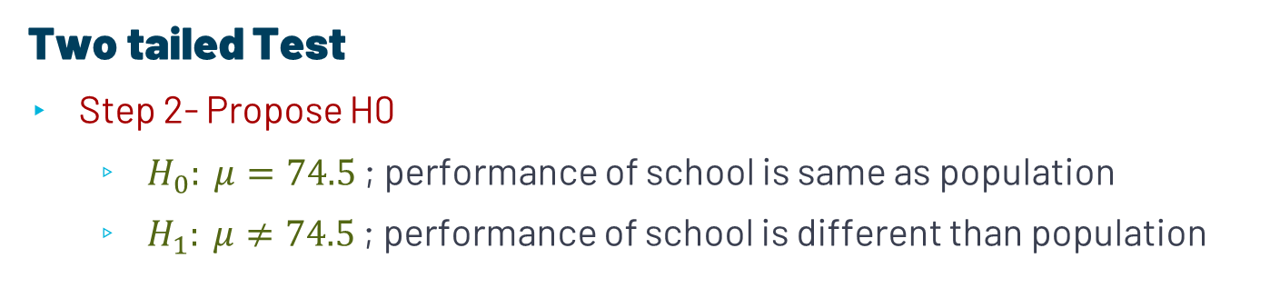
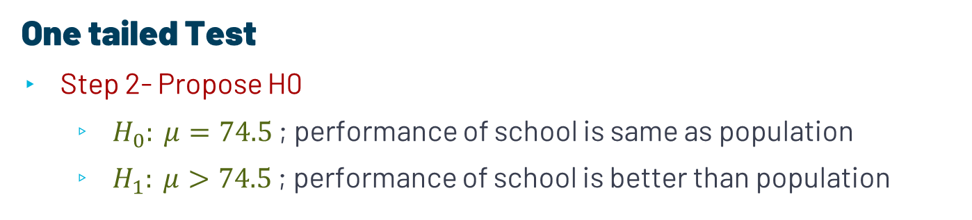
Cont..
One tailed Test
Step 2- Propose H0
$H_{0}: μ=74.5$ ; performance of school is same as population
$H_{1}: μ>74.5$ ; performance of school is better than population
Two tailed Test
Step 2- Propose H0
$H_{0}: μ=74.5$ ; performance of school is same as population
$H_{1}: μ≠74.5$ ; performance of school is different than population

Slide 10
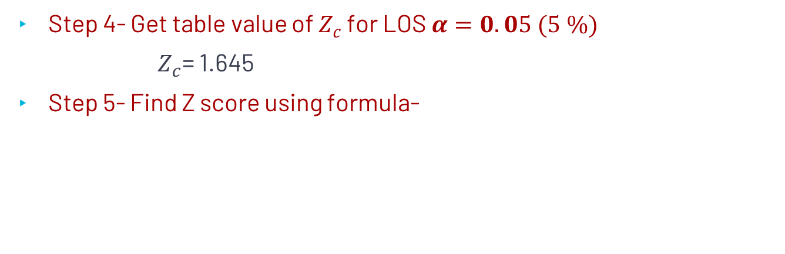

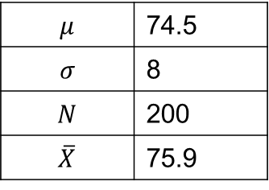
Cont.…
 | $$α=0.05 (5 \%)$$ | $$α=0.01 (1 \%)$$
Two-tailed Test | $Z_{c}$=1.96 | $Z_{c}$= 2.58
One-tailed Test | $Z_{c}$=1.645 | $Z_{c}$= 2.33
One tailed Test
Step 4- Get table value of $Z_{c}$ for LOS $α=0.05 (5 \%)$
$Z_{c}$= 1.645
Step 5- Find Z score using formula-
$$μ$$ | 74.5
$$σ$$ | 8
$$N$$ | 200
$$\overline{X}$$ | 75.9
$$Z=\frac{\overline{X}−μ}{\frac{σ}{\sqrt{N}}}$$
$Z=$2.4748

Slide 11
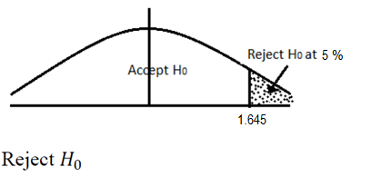
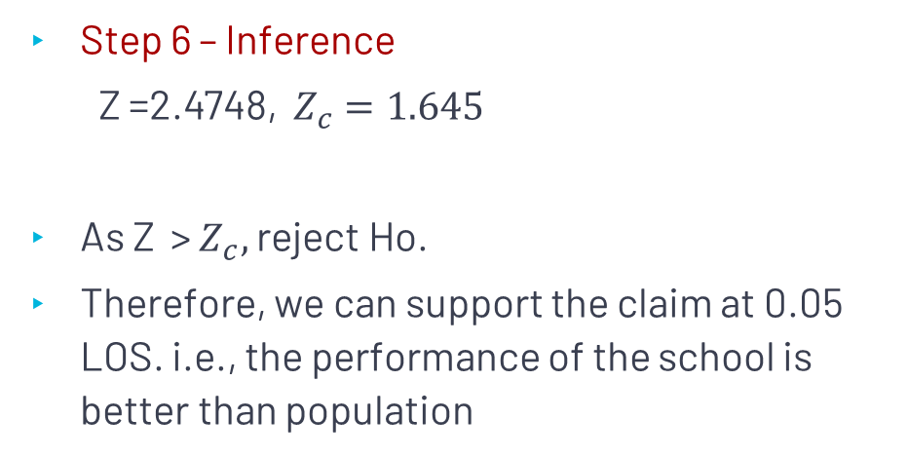
Cont. ..
Step 6 – Inference
$\text{Z}\text{ =2.4748, }Z_{c}=1.645$
As Z $\text{> }Z_{c},$reject Ho.
Therefore, we can support the claim at 0.05 LOS. i.e., the performance of the school is better than population

Slide 12
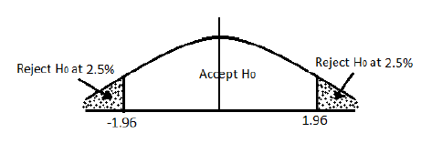
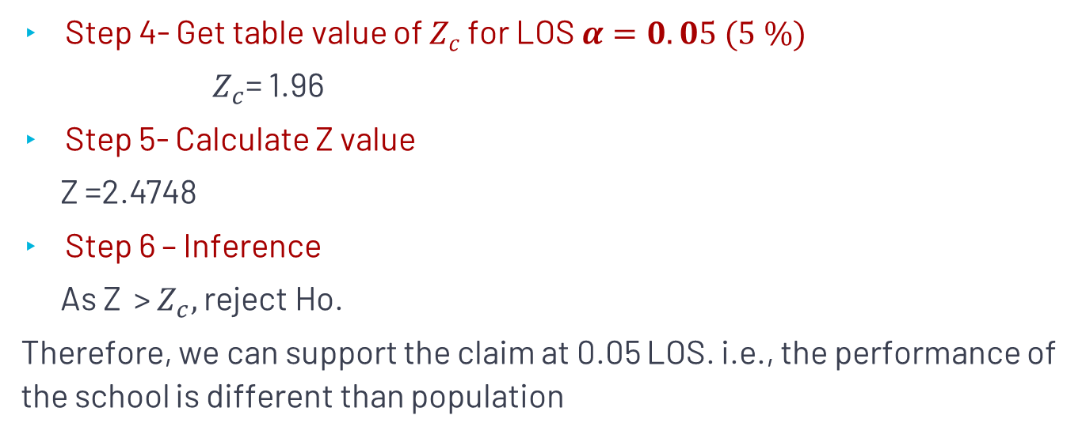
Cont.…
 | $$α=0.05 (5 \%)$$ | $$α=0.01 (1 \%)$$
Two-tailed Test | $Z_{c}$=1.96 | $Z_{c}$= 2.58
One-tailed Test | $Z_{c}$=1.645 | $Z_{c}$= 2.33
Two tailed Test
Step 4- Get table value of $Z_{c}$ for LOS $α=0.05 (5 \%)$
$Z_{c}$= 1.96
Step 5- Calculate Z value
$\text{Z}\text{ =2.4748}$
Step 6 – Inference
As Z $\text{> }Z_{c},$reject Ho.
Therefore, we can support the claim at 0.05 LOS. i.e., the performance of the school is different than population

Slide 13
Question
Internet shoppers spend on an average $335 per year with standard deviation $105. Three hundred Internet shoppers are surveyed, and it is found that the average spending is $324. Examine the scenario at 5 % LOS.

